Slide 1
3A & 3B HUMAN BIOLOGICAL SCIENCE
CHAPTER 12 –THE SKELETAL SYSTEM

Slide 2
FUNCTIONS OF THE SKELETAL SYSTEM
1. Support – gives shape and provides attachment for muscles
2. Movement – Bones articulate at joints, that is, they are able to move at points where they join
3. Protection – the skeleton surrounds and protects many of the vital organs, for example, the brain is protected by the cranium; the reproductive organs are protected by the pelvis; the heart and lungs are protected by the ribcage.
4. Storage – mineral salts and fats are stored by the bones of the skeleton, for example, calcium, phosphorus, sodium and potassium
5. Blood cell production – red marrow in certain bones produces red blood cells

Slide 3
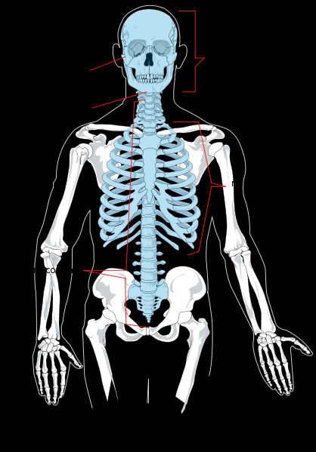
The Axial and Appendicular Skeletons
Axial Skeleton
Consists of the bones that lie along the central axis of the body, providing main support for erect posture, protects the central nervous system and thoracic organs. Bones include the skull, vertebral column, ribs and sternum.
http://upload.wikimedia.org/wikipedia/commons/thumb/8/8b/Axial_skeleton_diagram.svg/418px-Axial_skeleton_diagram.svg.png

Slide 4
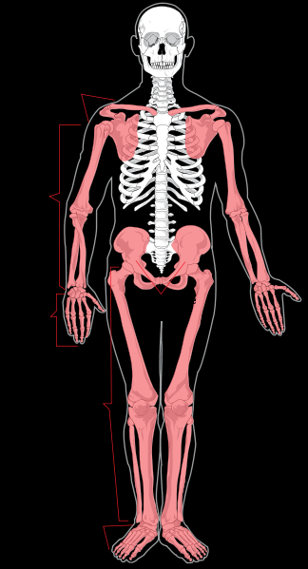
Appendicular Skeleton
Consists of bones making up the upper and lower limbs and the bones of the pectoral (shoulder) and pelvic (hip) girdles.
http://upload.wikimedia.org/wikipedia/commons/thumb/7/7c/Appendicular_skeleton_diagram.svg/324px-Appendicular_skeleton_diagram.svg.png

Slide 5
Axial & appendicular skeleton
Axial skeleton
Skull
Vertebral column (backbone)
Ribcage
Appendicular skeleton
Pectoral girdle
Upper limbs
Pelvic girdle
Lower limbs

Slide 6
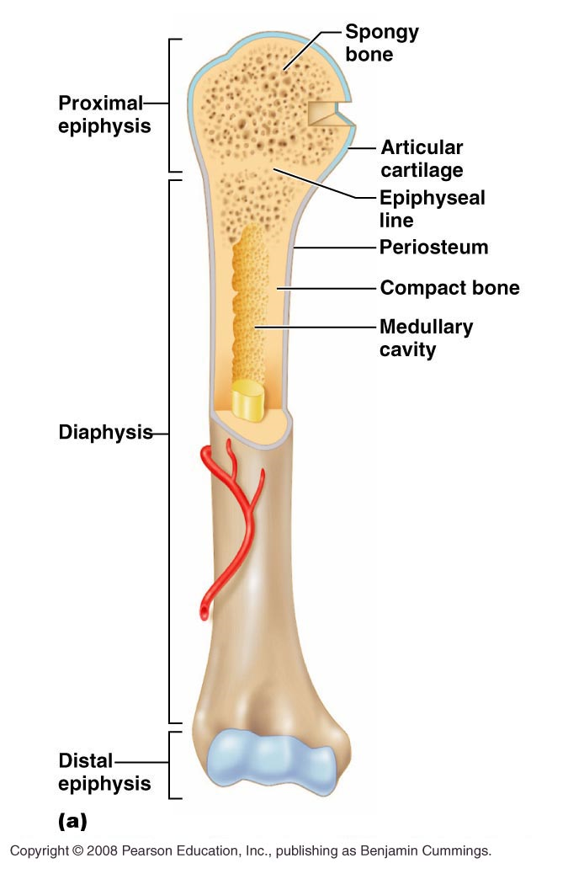
http://stevebambas.com/images/AP%20220%20Long%20BoneL.jpg
THE STRUCTURE OF BONE
STRUCTURE | DESCRIPTION | FUNCTION
Diaphysis | The shaft of a long bone | The main force-bearing portion of a bone
Epiphysis | The enlarged ends of the bones | Provides articular surfaces contacting other bones; growth occurs here
Compact bone | Very hard, dense connective tissue | Forms the diaphysis and the outer layer of a long bone
Yellow bone marrow cavity | Cavity in the middle of a long bone also called the medullary cavity | Hollow cavity that stores fatty bone marrow
Spongy bone | An irregular arrangement of thin bony plates called trabeculae | Hard tough bone fibres with many spaces; strong and lightweight
Articular cartilage | Shiny smooth tough layer on the articular surfaces of bones | Friction free surfaces for contact with other bones
Periosteum | Tough fibrous outer covering on the epiphyses of bones | Protection of bones, attachment of muscles

Slide 7
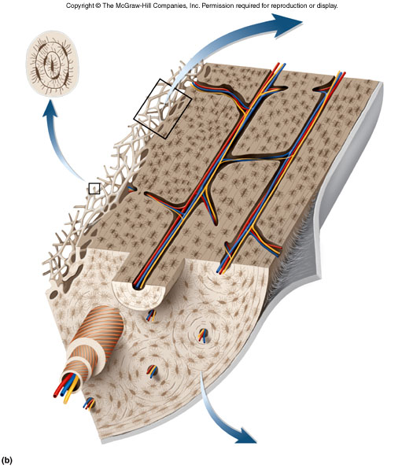
THE MICROSCOPIC STRUCTURE OF BONE
Consists of cells separated by a non-cellular matrix made of inorganic salts (mostly calcium and phosphate).
Compact bone is made many similar units called Haversian systems or osteons.
Spongy bone is made of thin bony plates called trabeculae.
http://waukesha.uwc.edu/lib/reserves/pdf/zillgitt/zoo234/diagrams/unit2/ZOO%20234%20Unit%202%20Bone%20Tissue%20Three%20Dimensional%20Structure%20of%20Compact%20Bone.jpg

Slide 8
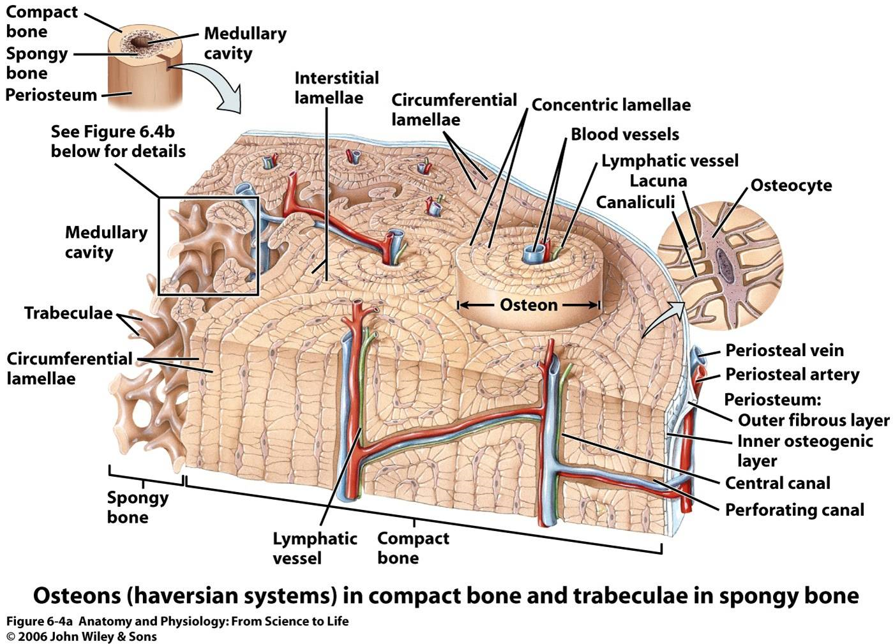
http://skylliceous.unblog.fr/files/2009/02/picture1.jpg

Slide 9
TYPES OF CARTILAGE
TYPE | STRUCTURE | CHARACTERISTICS | LOCATION
HYALINE | Contains many closely packed collagen fibres in the matrix | Great strength, toughness but also flexibility | Rings of the bronchi and trachea and on articulating bone surfaces
ELASTIC | Elastic & collagen fibres are not so tightly packed | Flexible elastic support | External ear, epiglottis
FIBRO-CARTILAGE | Thick coarse collagen fibres in bundles | Strength and toughness but can be compressed, ideal for supporting weight | Intervertebral discs, articular cartilage of knee joint, between pubic bones joining the two sides of the pelvis

Slide 10
Joint classification
Joints can be classified by their structure and the amount of movement they allow.
Structure | Joint cavity | Movement
Fibrous | None | None
Cartilaginous | None | None or slight
Synovial | Present | Freely movable

Slide 11
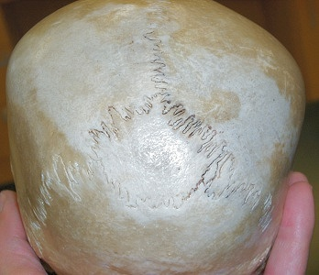
JOINTS
Joints are where two or more bones come together.
Fixed or fibrous joints
No movement occurs between the bones involved. Bones are held in place by fibrous connective tissue. Very strong, difficult to damage. For example, bones of the skull and where the teeth are embedded into the jaw..
http://faculty.clintoncc.suny.edu/faculty/Michael.Gregory/files/Bio%20102/Bio%20102%20lectures/Motor%20Systems/immovable_joint.jpg

Slide 12
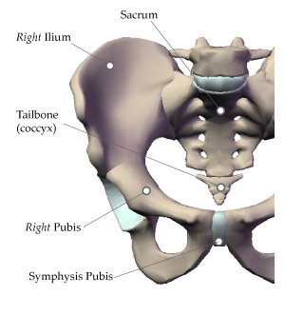
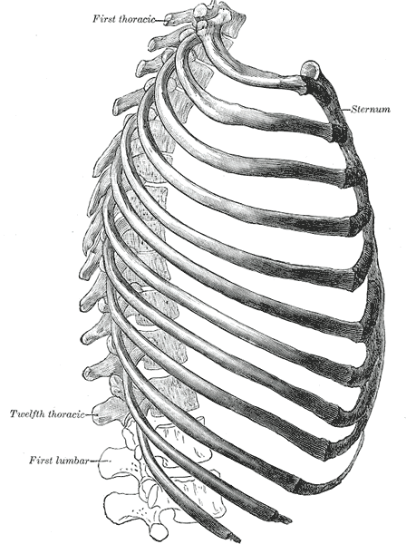
Slightly movable or cartilaginous joints
Joints are held in place by fibrocartilage, allows slight movement. For example, the pubis symphysis, and the joints between the ribs and the sternum
http://www.etonia.com.sg/images/Pelvic-Bones.jpg
http://retilde.files.wordpress.com/2007/10/gray114.png

Slide 13
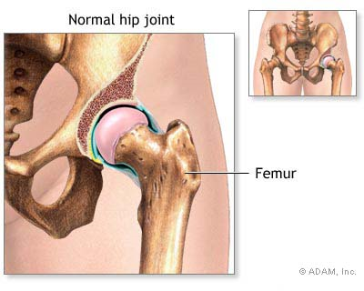
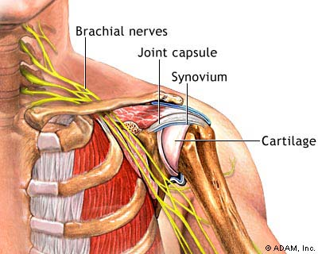
Freely Movable or Synovial Joints
Freely movable. These are found at the shoulder, elbow, wrist, fingers, hip knee, ankle and toes.
1. Ball & socket Joints – the spherical head of one bone fits into a cup-like cavity of another
http://graphics8.nytimes.com/images/2007/08/01/health/adam/7015.jpg
http://graphics8.nytimes.com/images/2007/08/01/health/adam/19623.jpg

Slide 14
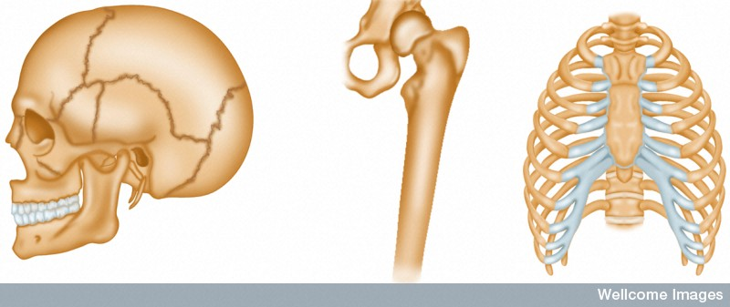
Types of joints
Immovable fibrous joint
Movable synovial joint
Slightly movable cartilaginous joint
Wellcome Photo Library

Slide 15
Hinge joint
Flexion
Extension
Abduction
Ball & socket joint
Circumduction
Adduction
Adduction
Pivot joint
Rotation

Slide 16
Movement at a joint
The types of movement that occur at a joint are:
Flexion (bending): This decreases the angle between the articulating bones (for example, bending the knee or elbow)
Extension (straightening): This increases the angle between the articulating bones (for example, straightening the arm or leg after flexion)
Abduction is movement away from the midline of the body (for example, lifting the arms upwards and outwards)
Adduction is movement towards the midline of the body (for example, returning the arms to the sides after abduction)
Rotation is the movement of a bone around its long axis (for example, rotation of the humerus occurs when the palm is twisted up from the shoulder).

Slide 17
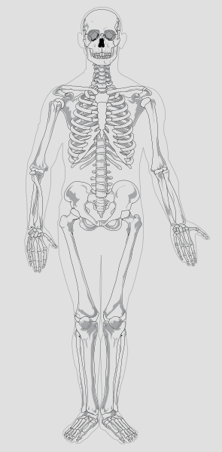
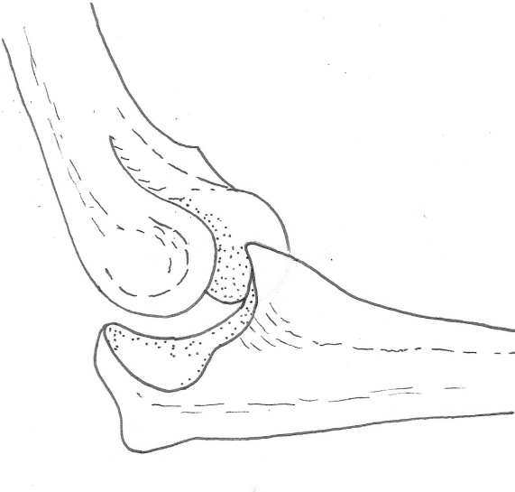
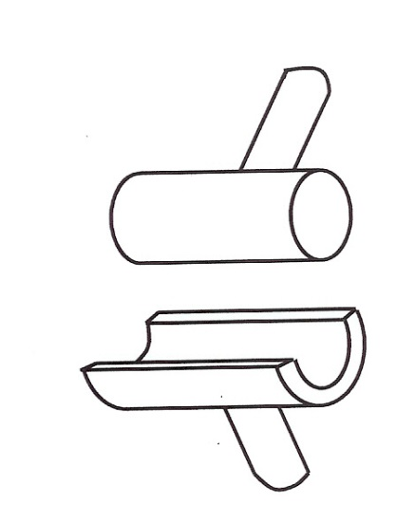
Hinge joint
Mariana Ruiz Villarreal

Slide 18
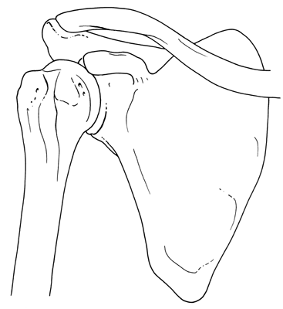
Ball and socket joint
Mariana Ruiz Villarreal

Slide 19
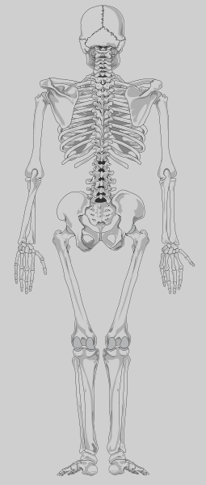
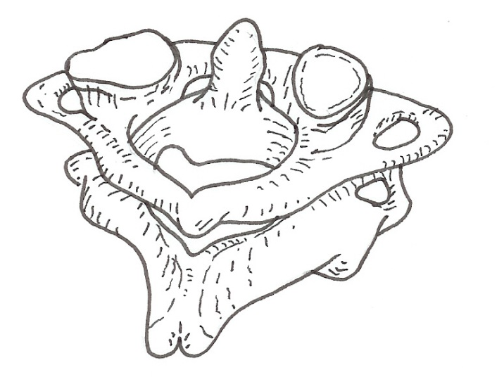
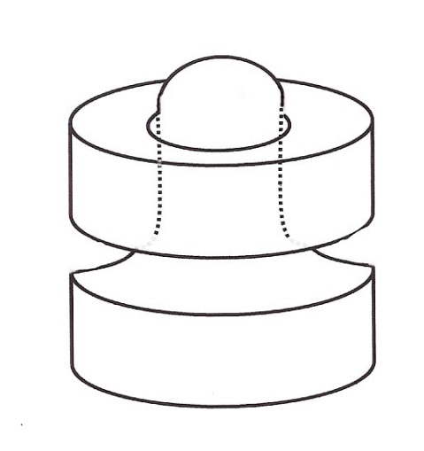
Pivot joint
Mariana Ruiz Villarreal

Slide 20
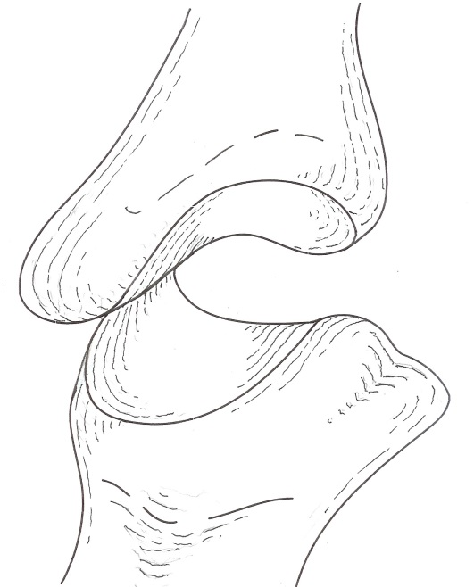
Saddle joint
Mariana Ruiz Villarreal

Slide 21
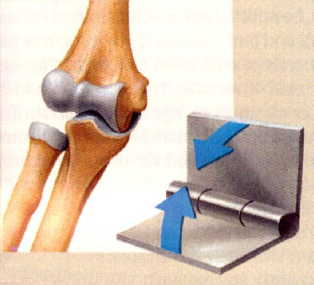
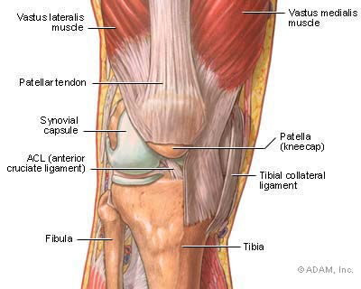
2. Hinge Joints – allow movement only in one plane like a door. Formed when the convex surface of one bone fits into the concave surface of the other. Examples: elbow, knee, ankle, fingers.
http://www.shockfamily.net/skeleton/HINGE.JPG
http://graphics8.nytimes.com/images/2007/08/01/health/adam/19399.jpg

Slide 22
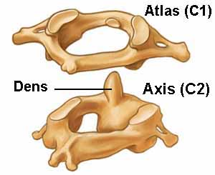
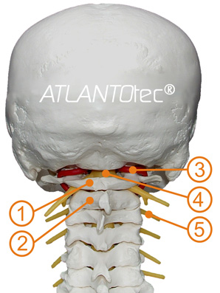
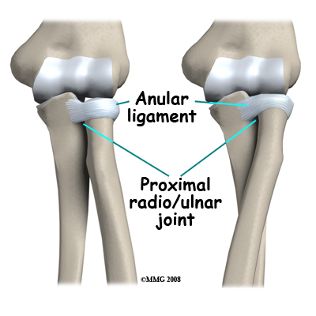
3. Pivot Joints – formed when the rounded, pointed or conical end of one bone articulates with a ring of bone, for example the atlas and the axis supporting the cranium on top of the vertebral column, and the radius and ulna, where the annular ligament wraps attached to the ulna wraps around the radius allowing it to rotate.
1) Atlas 2) Axis 3) Vertebral artery 4) Spinal medulla 5) Spinal nerves
http://www.atlantotec.com/images/stories/maindoc/schaedel.jpg
http://www.eorthopod.com/sites/default/files/images/adult_elbow_fx_anatomy03.jpg

Slide 23
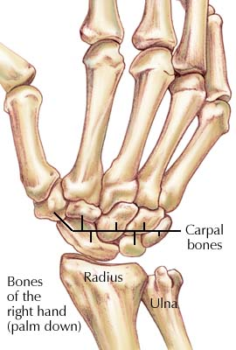
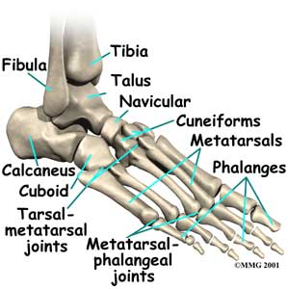
3. Gliding joints – allow movement in any direction with restriction from the ligaments and processes of surrounding bones. Examples are found in the carpal bones, tarsal bones, sternum and clavicle, and the scapula and clavicle.
http://www.chiropractic-help.com/images/foot_bones.jpg
http://www.hughston.com/hha/b.wrstfx1a.jpg

Slide 24
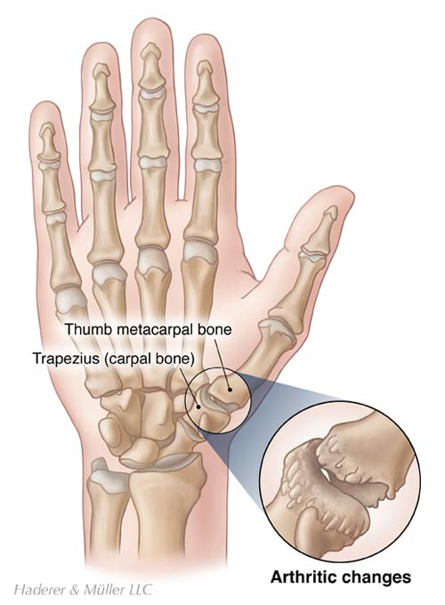
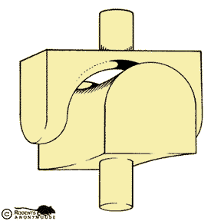
Saddle joint – only one of these where the metacarpal of the thumb joins the carpal bone (wrist). The two bones are both saddle shaped, concave in one direction , convex in the other, allowing both side-to-side and back-and –forth motion.
http://www.heumann.org/body.of.knowledge/a8/rdts45.gif
http://www.nyphysicaltherapy.net/portals/2/medicallibraryassets/pt/cmcarthrofinal_large.jpg

Slide 25
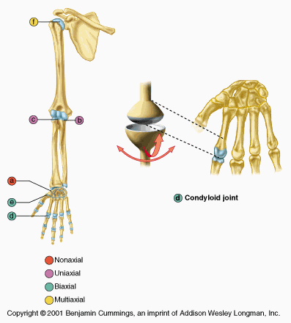
Condyloid or Ellipsoid joints – have one surface slightly convex which fits into the other surface which is slightly concave. For example, between the radius and the carpals, the metacarpals and phalanges, and the metatarsals and phalanges.
http://legacy.owensboro.kctcs.edu/gcaplan/anat/Notes/Image590.gif

Slide 26
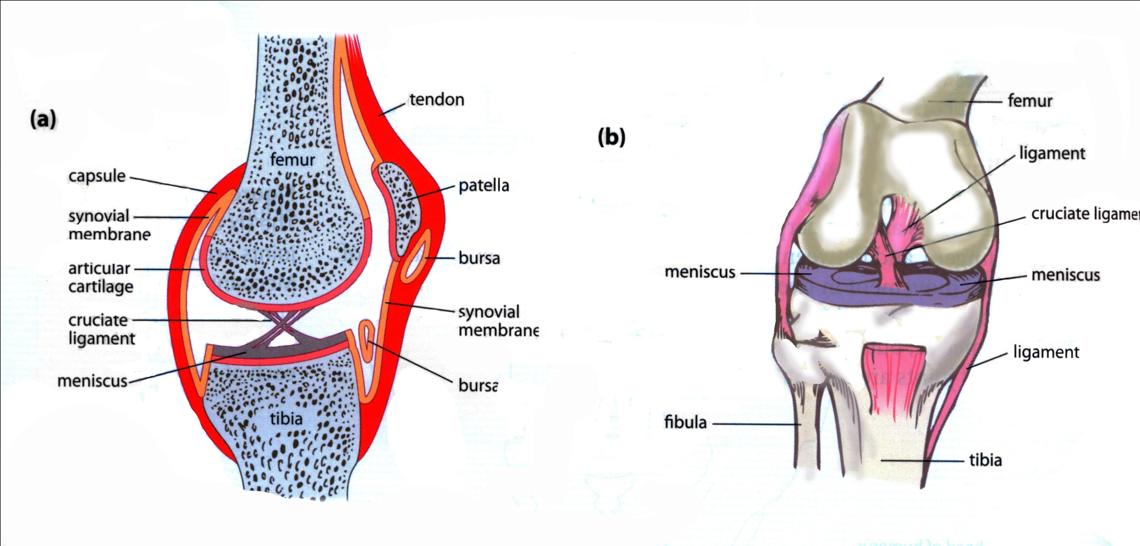
Structure of a Synovial Joint – (Diagram from Human Perspectives 3A/3B page 200, Figure 12.13)

Slide 27
Name | Description | Function
Capsule | Cartilage sac composed of two layers – an outer fibrous layer, and an inner membrane | Surrounds and encloses the joint
Fibrous capsule | Dense fibrous connective tissue attached to the periosteum of the articulating bones | Flexibility permits movement, and strength prevents dislocation
Synovial Membrane | Loose connective tissue inside the fibrous capsule well supplied with blood vessels | Secretes synovial fluid into the synovial cavity
Synovial Fluid | Similar in appearance and consistency to egg white, forms a thin film over surfaces in the capsule, contains phagocytic cells | Lubricates the joint, provides nourishment for cells of the articular cartilage, removes microbes and debris
Articular Cartilage | Smooth tough cartilage that covers articulating surfaces of the joint | Provides smooth surfaces that have little friction
Articular discs | Fibrocartilage menisci extend inward from articular cartilage | Divide the synovial cavity into two, directing synovial fluid to areas of greatest friction
Bursae | Small sacs of synovial fluid | Reduce friction between bones and ligaments or tendons, or between bone and skin
Accessory Ligaments | Extra ligaments in the joint | Hold the bones together, particularly during extended movement

Slide 28
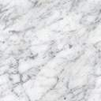
The End
Of the
Chapter 12 Presentation

